Slide 1
Final Packaged Sunscreen Proposal
By: Casey Feinstein, Emory Gatchell, Hadley Saba, Oyinade Oyenusi, and Amber Bustard

Slide 2
Goals for this project
Optimize the mixture of om cinnamate and oxybenzone in both safety and maximum SPF value
Achieve the lowest possible cost of sunscreen materials
Create a low cost package to hold the sunscreen mixture of 88mL and pass material testing

Slide 3
Summary of the Product Constraints

Slide 4
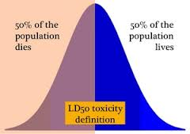
Product Constraints for LD50 TEST AND mAX sPF
What is the LD50 test?
A test to determine the amount of a toxic agent that is sufficient to kill 50 percent of a population of animals usually within a certain time.
Goal of the LD50 tests
Determine greatest amount of the om cinnamate and oxybenzone that can be used in the sunscreen formula.

Slide 5
COSTS
Maximum Budget:
$4.00 without glue
$3.00 with glue
Minimum Budget:
We found the lowest cost per unit of the sunscreen ingredients through research online.
Goal:
To have the lowest cost of the products used to create the packaging, and to engineer the sunscreen formula.

Slide 6
Highest Packing Materials Testing Criteria
Materials Testing Criteria
Drop Test
Shake Test
Weight Test
Throw Test
Water Test
Heat Test
Marketing Test

Slide 7
Final Sunscreen Formula & Cost

Slide 8
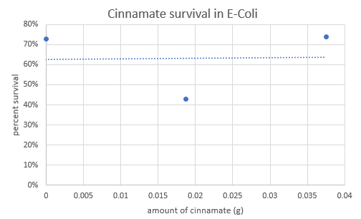
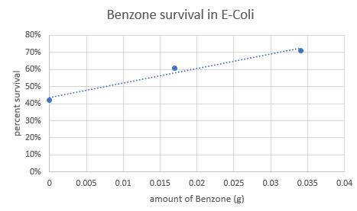
E-Coli SAFETY DATA
Cinnamate LD50 amount= 0.0375g
Benzone LD50 amount= 0.0341g
Conclusions: The survival rate of E-coli in both the benzone and cinnamate was steady. Because of our success with the E-Coli data (unicellular organism), we decided to move onto testing with multicellular organisms…

Slide 9
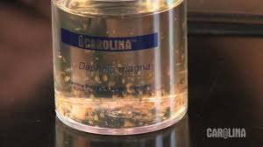
Acute Toxicity Testing
Instead of using E-Coli, Daphnia was used to better simulate complicated organisms like humans.

Slide 10
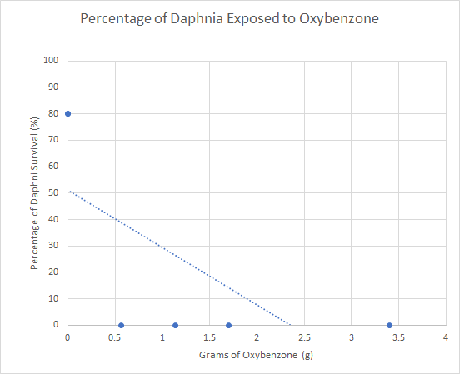
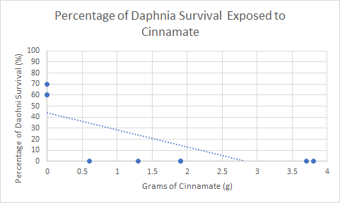
Daphnia Safety Data
Oxybenzone LD50 amount: 0.0605 grams
Om cinnamate LD50 amount: 0 grams
Conclusions: Daphnia died in the presence of cinnamate and benzone. 21.7% of daphnia lived in cinnamate and 26.7% of daphnia died in benzone. After further research, we found that the chemicals are not soluble in water, which is likely the cause the daphnia deaths (since they live in water).

Slide 11
Making the sunscreen
For benzone and cinnamate in our formula, at first we used 100% of the legal amount of each chemical (benzone- 6% and cinnamate- 7.5%)
The FDA has already validated these amounts through LD50 tests and are used in other sunscreens.
Remaining ingredient amounts (cetyl alcohol, steric acid, glycerin, trethanol amine, and distilled water) were provided in advance

Slide 12
Human Safety test #1
Amount of Cinnamate: 6.6g (100% of legal limit)
Amount of Benzone: 5.28g (100% of legal limit)
Observations of Sunscreen:
Thick texture → thicker than test subject lotion
Day # | Observations
0 | 2:28pm: Applied sunscreen (1.5cm x 1.5cm square) 2:40pm: itchness (1.5-2)
1 | 11:27pm: no itchiness or redness 5:00pm: redness (2) but disappeared
Notes:
So first put the observations

Slide 13
Making the sunscreen part 2
However, after testing, we decided to lower our chemical amounts to 75% of the legal amounts due to some discomfort felt by our human subject (Mr. Brock).

Slide 14
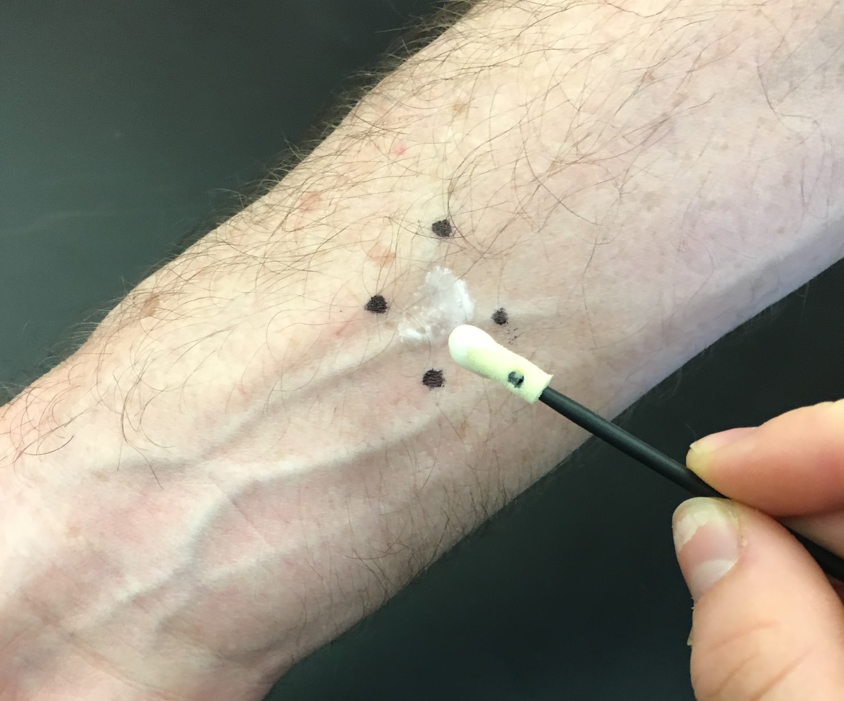
Final Human Safety Test
Amount of Cinnamate: 5.2g (79%)
Amount of Benzone: 4.5g (85%)
Observations of Sunscreen:
Thin, more liquid like formula
Day # | Observations
0 | 9:15pm: application (1.5cm x 1.5cm square) 12:40pm: no redness or itchiness
1 | 2:25pm: itchniess (1.5)

Slide 15
Total cost and amount of chemicals
Ingredient Cost Amount
Cetyl alcohol---- $0.003----- 2g
Steric acid------ $0.032----- 4g
Glycerin--------- $0.006----- 2g
Trethanol amine-- $0.015----- 1g
Distilled water-- $0.09------ 78g
Benzophenone----- $0.0045---- 4.5g
Om cinnamate----- $0.0052---- 5.2g
*We found the chemicals from websites (referenced in Appendix Slide 33) in bulk and calculated the price of the specific amount needed for our formula.
Total cost= $0.16

Slide 16
Experiment, Data, and Analysis
10 daphnia were in each amount of cinnamate or benzone (maximum, minimum, or control).
On average, 7.2 daphnia lived in the control (this average does not include our outlier of Benzone trial 2).
0 daphnia lived in the maximum amount.
In outlier set of data, only 1 daphnia lived in the minimum amount (.85 grams of benzone), other than that 0 daphnia lived in the minimum amounts.

Slide 17
Final Package & Cost

Slide 18
Materials Testing
Drop Test
Shake Test
Weight Test
Throw Test
Water Test
Marketing Test
Heat Test
Environmental Considerations (bonus)
Scale: 1-3
1 = Lots of damage
2 = Little damage
3 = No damage

Slide 19
Top 3 Materials… Which ones are going to protect our package?
From our materials testing, we recommend for our package:
Duct Tape: Strong; keeps package together reliably
Average Score: 2.5
Cardboard: Strong and sturdy; malleable into our desired triangle shape
Average Score: 2.67
Wax paper: Protects package from water damage; extra layer of strength
Average Score: 2.7

Slide 20
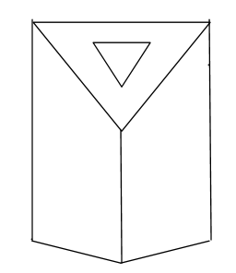
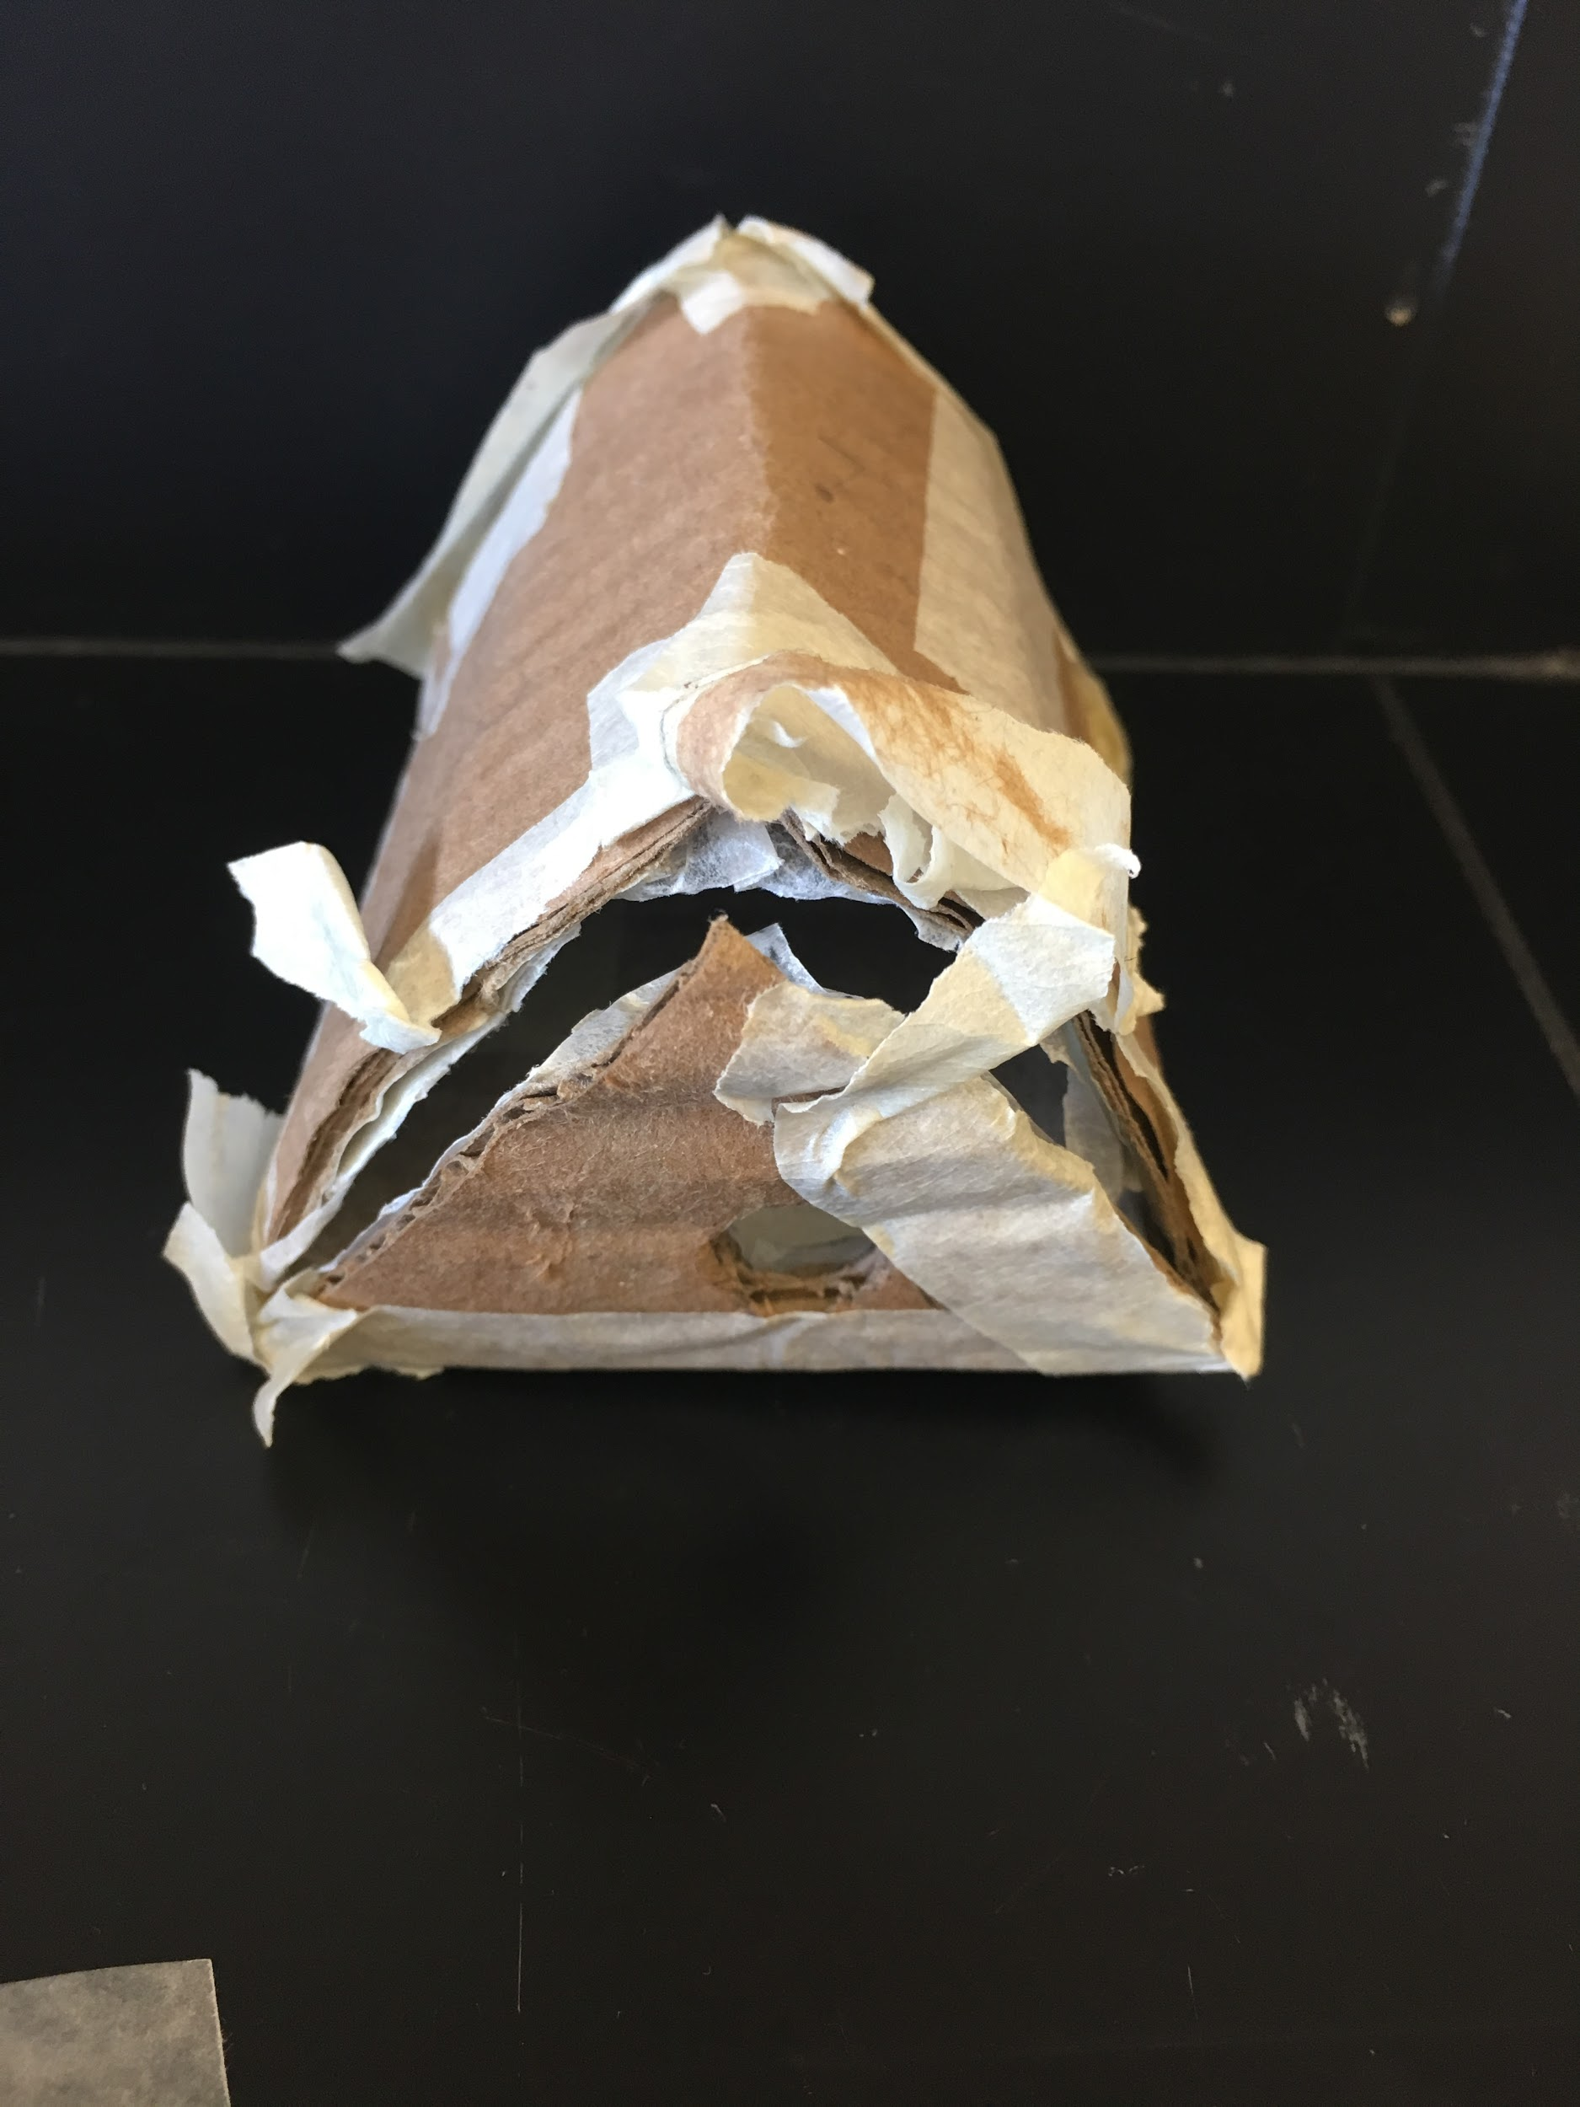
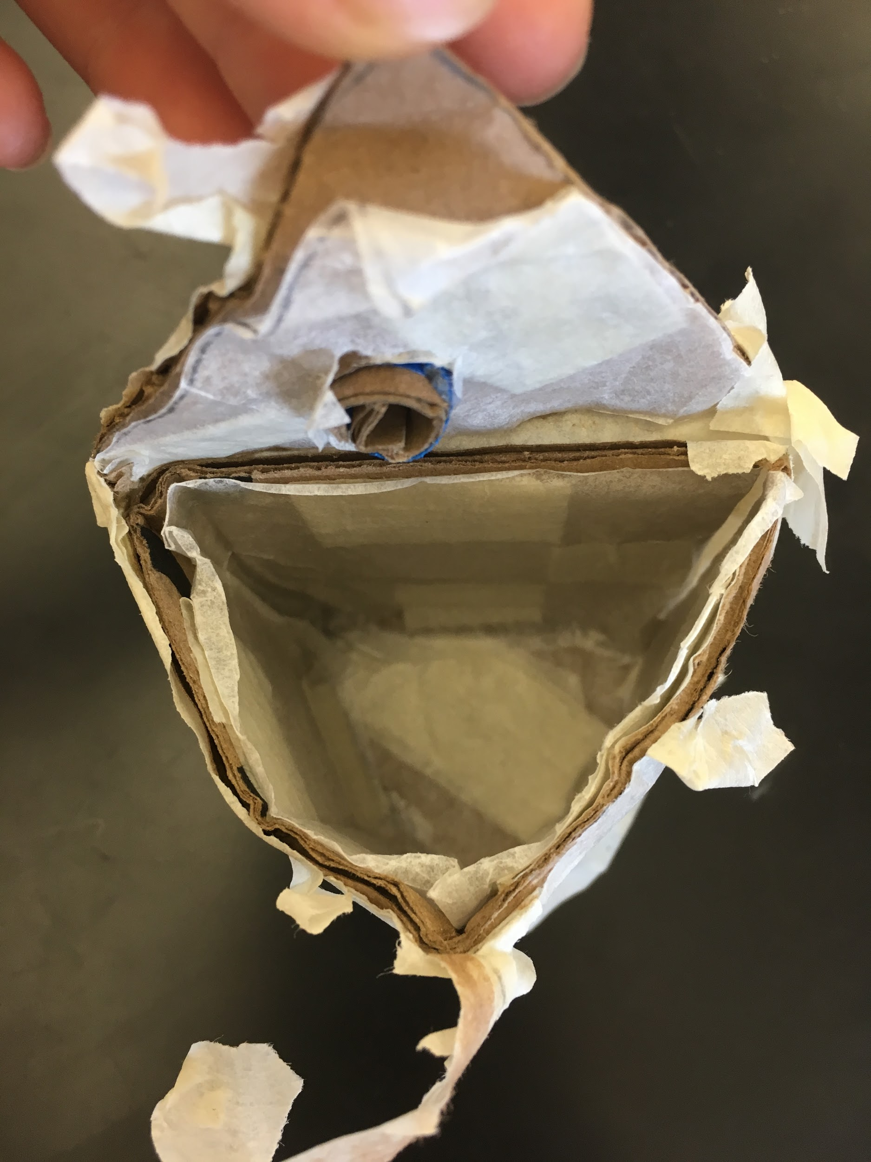
Design Sketch → first prototype
7.5cm
1cm
8cm
First Prototype Average Test Score - 2.375
Triangle → strongest shape

Slide 21
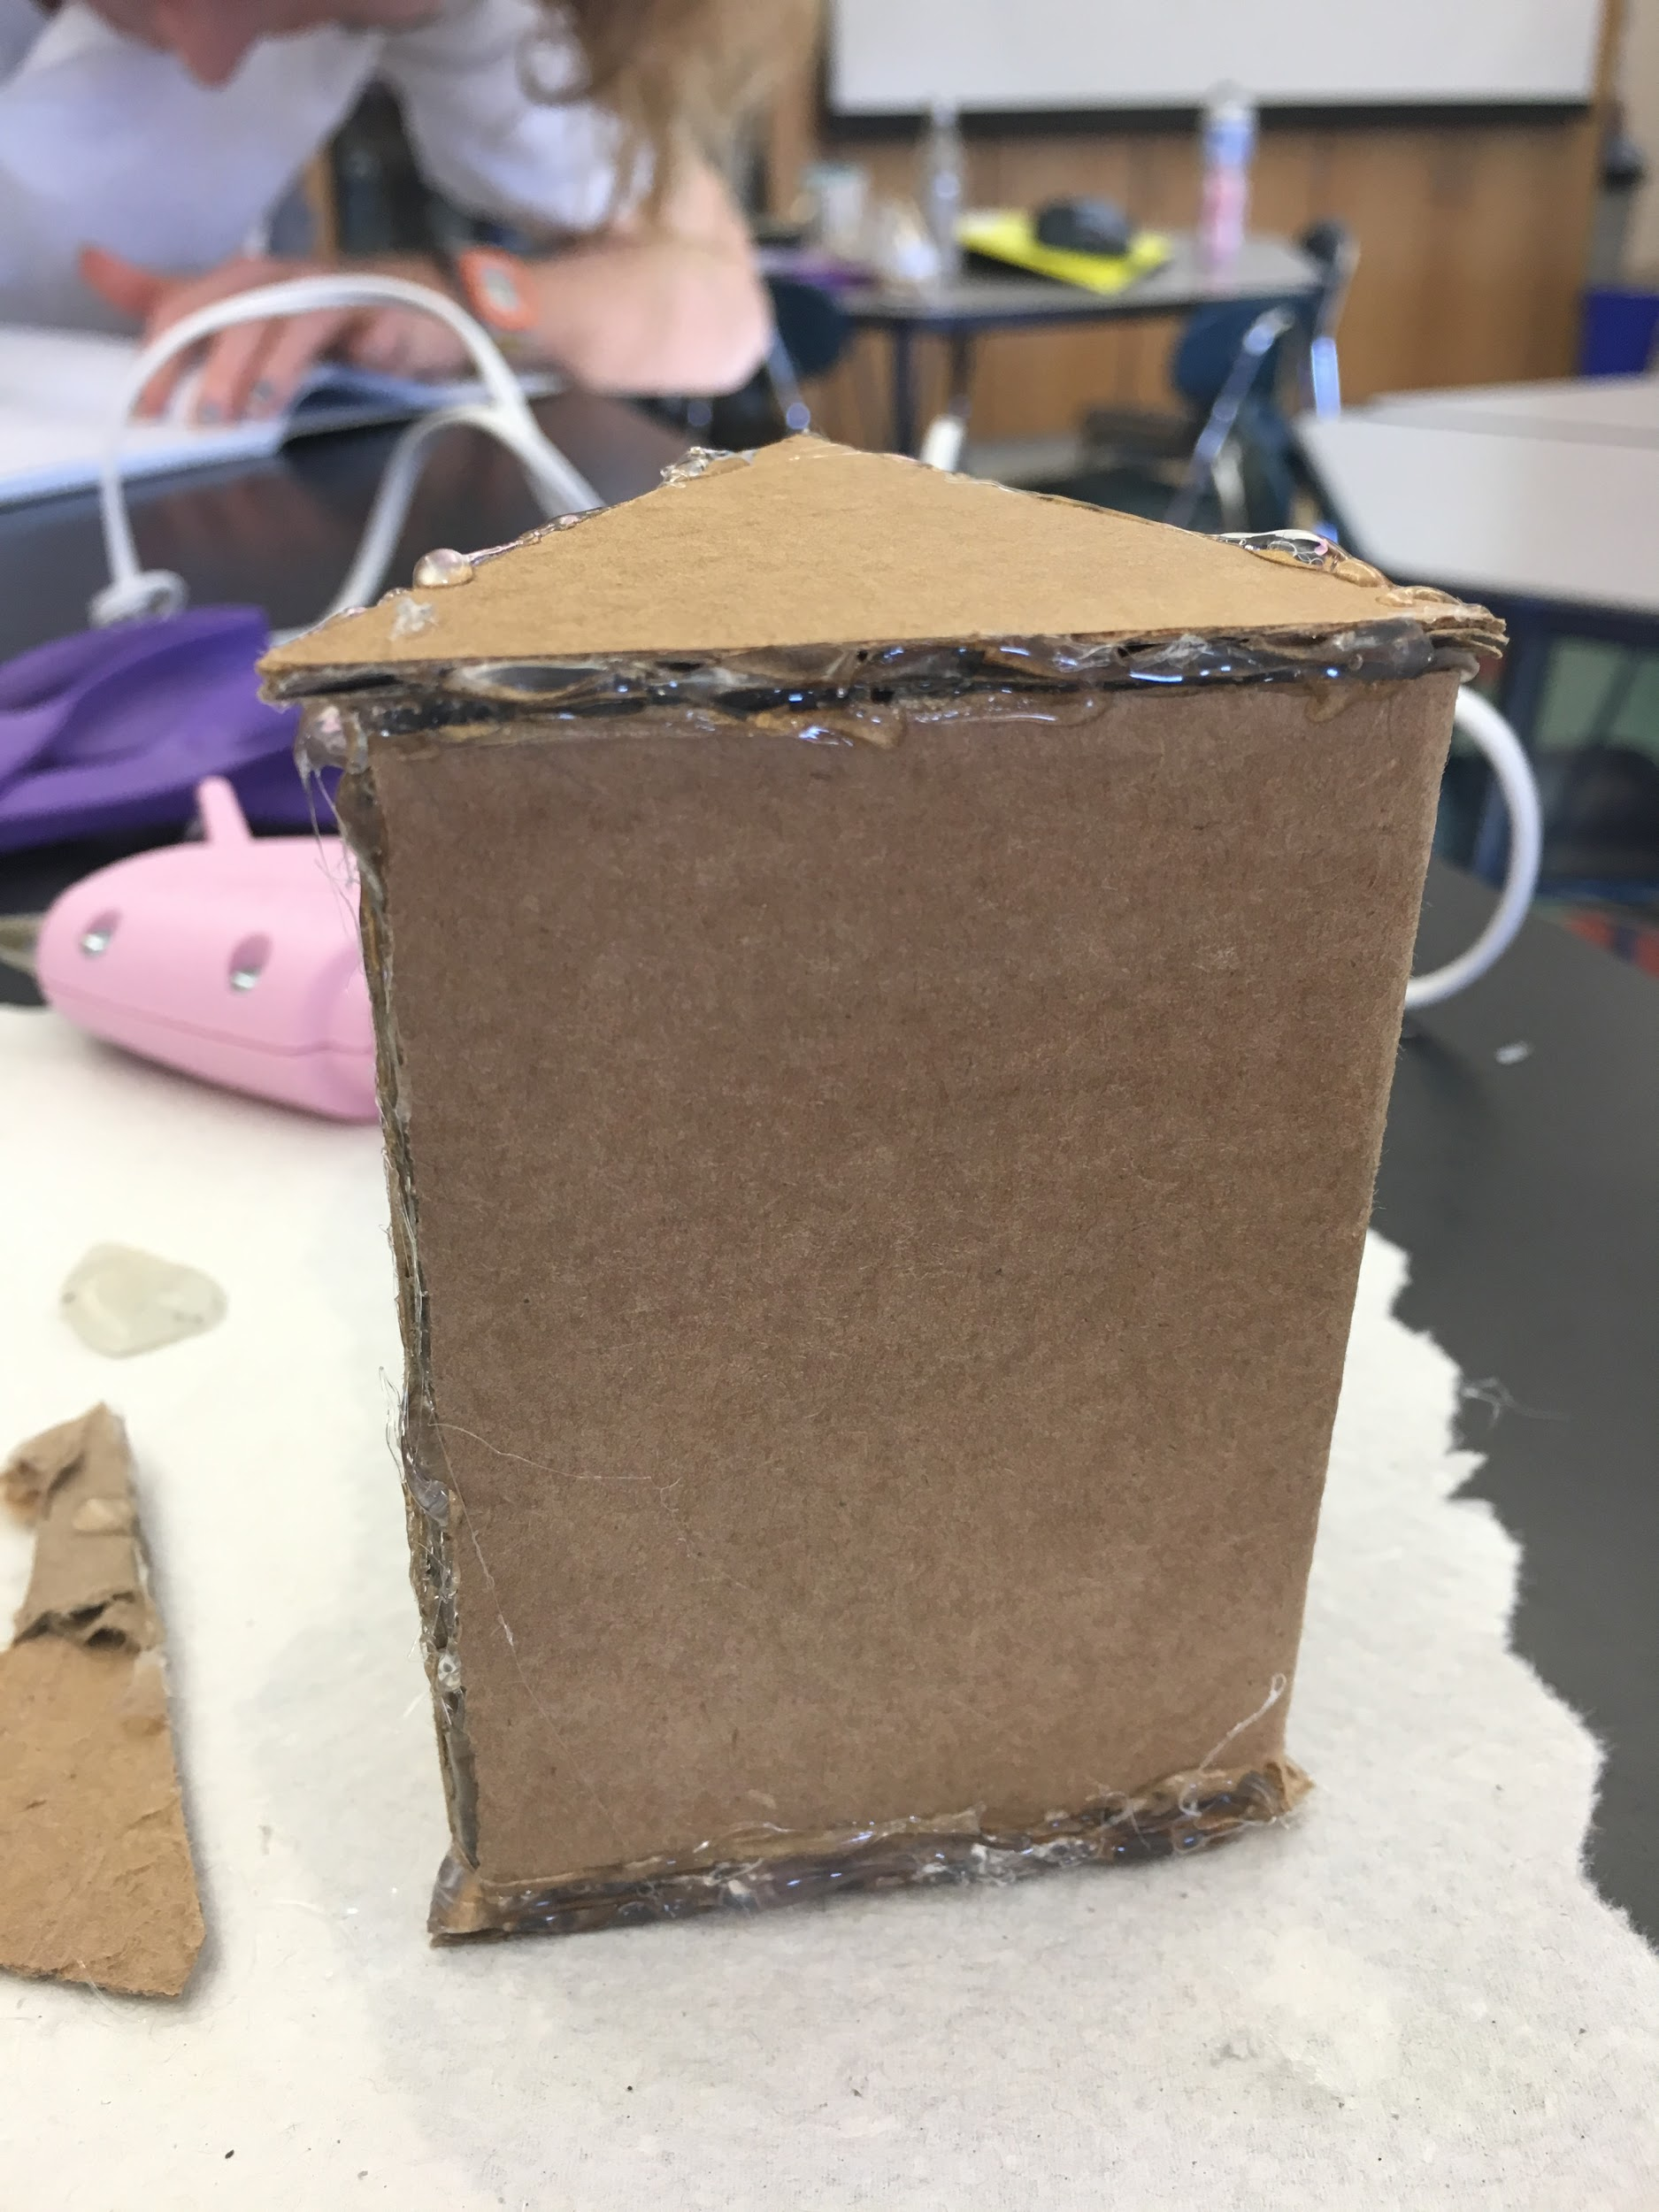
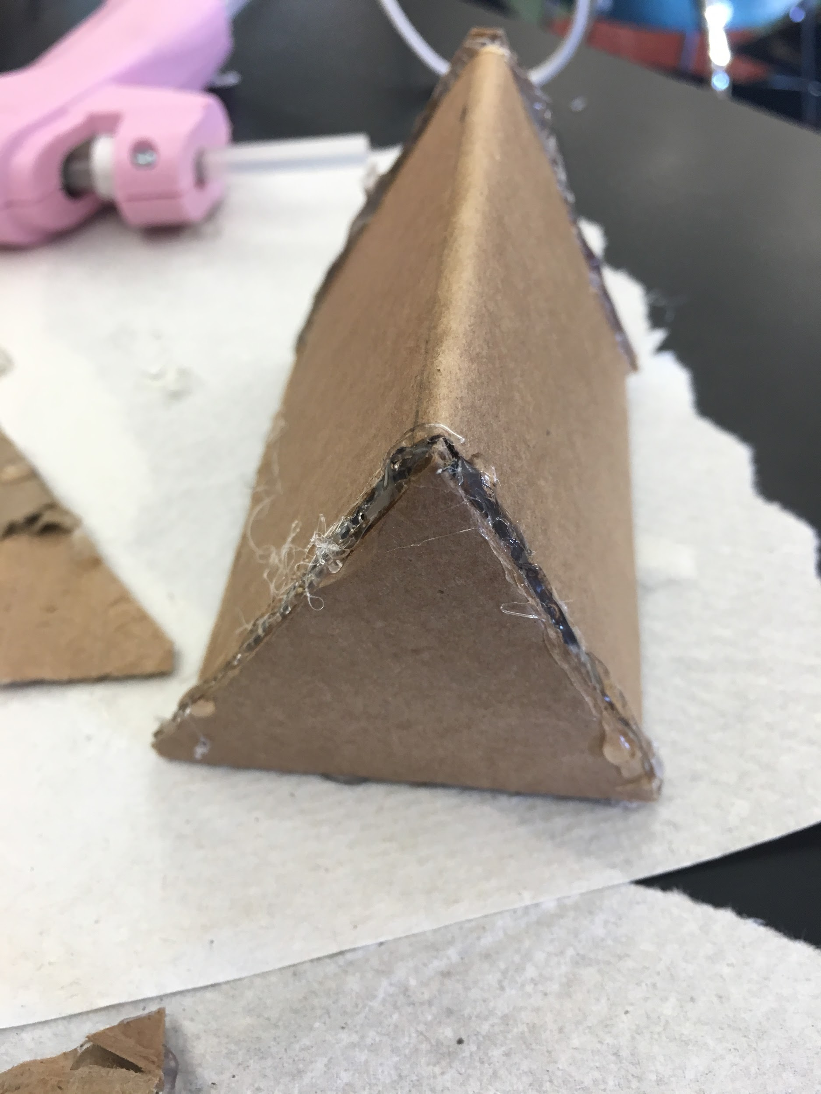
Building the Second Prototype
We tested this design to help us establish a final structure for our package. Average Score: 2.883

Slide 22
Creating the Third Package
Cardboard: Strong and sturdy
Wax paper (on exterior): protects the package from water
Glue: Does not break/come undone due to tests (unlike tape)
Average score: 2.583
Modifications:
Plastic seal over opening of package → cap/plug → prevents sunscreen from spilling out
To use: cut or peel the plastic wrap

Slide 23
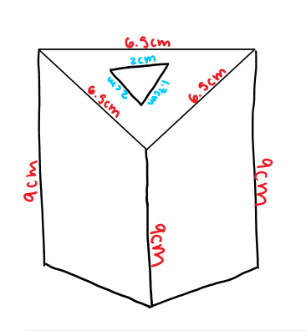
Package Modifications Design Sketch

Slide 24
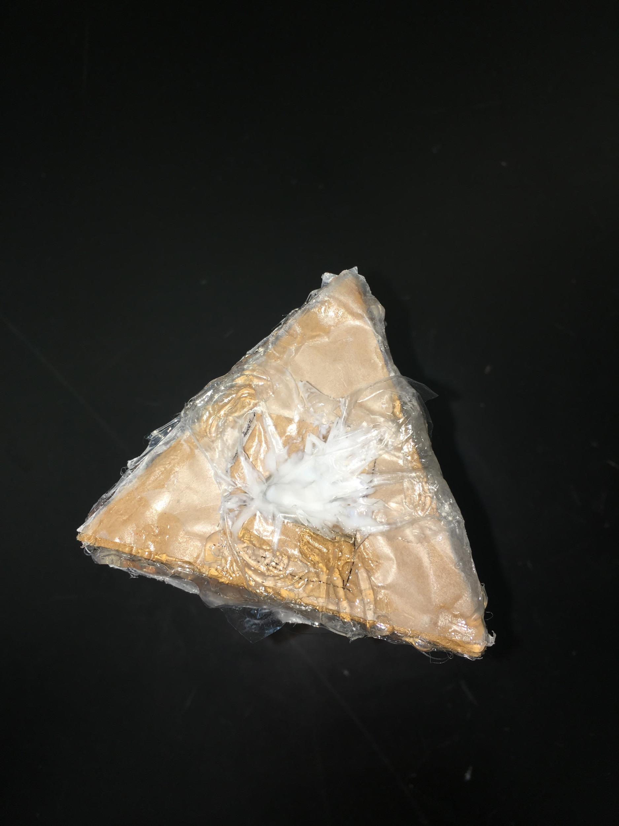
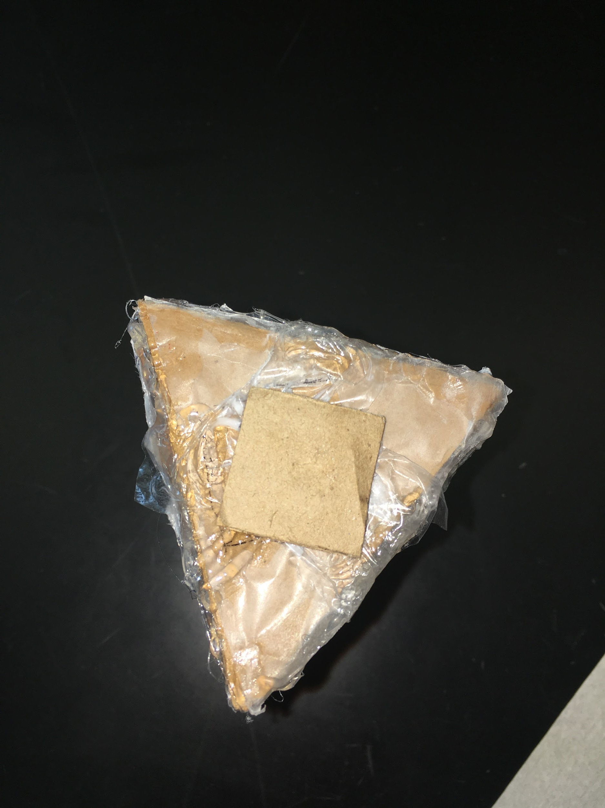
Fourth Prototype
Observations:
The overall package survived the water test fine, but the cap got soggy and peeled.
The average score for this test was 2.833

Slide 25
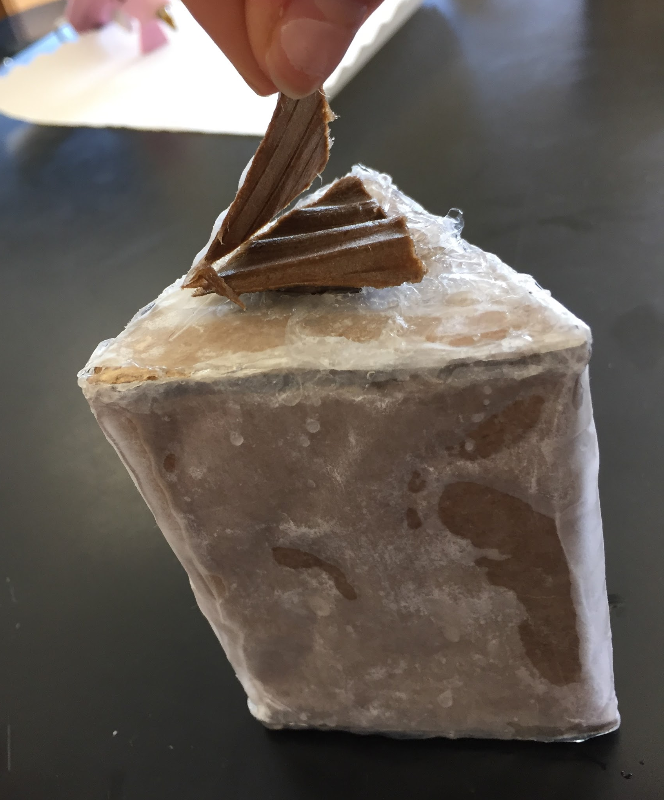
Damage of Fourth Package

Slide 26
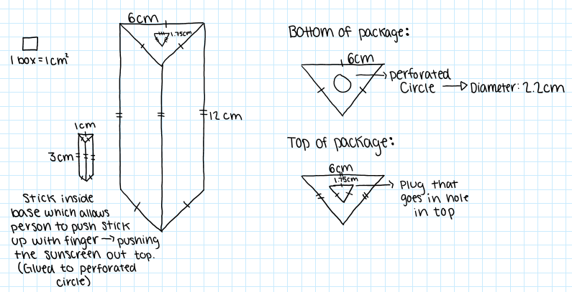
Final Package Design

Slide 27
Final Package
Perforated circle on bottom of package with 3cm plunge inside package connected
Allows for easier accessibility to sunscreen

Slide 28
Final Package cost
1 piece of cardboard ($1.00/square)
1 plastic bag ($0.25/each)
1 piece of wax paper ($0.50/piece)
1 piece of plastic wrap ($0.75/piece)
Glue
Total cost of packaging= $2.5o

Slide 29
marketability
Choice of orange:
Summer color
Aesthetically pleasing
Happy color
Ombre:
Aesthetically pleasing

Slide 30
Environmental impact
Cardboard: recyclable
Wax paper: compostable and degrades quickly

Slide 31
APPENDIX

Slide 32
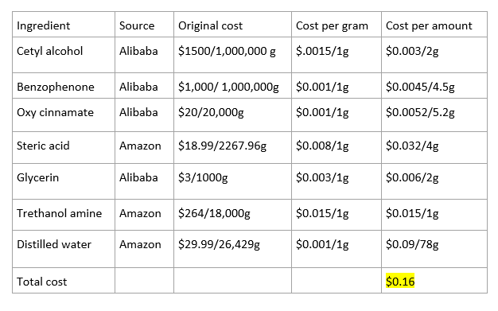
Full cost analysis

Slide 33
LD50 E. coli analysis
As the amount of chemicals increased for both tests, the survival rate of the e-coli decreased, more drastically for benzone than cinnamate.
Benzone killed off 50% of a population in a higher quantity than cinnamate, with a major survival percentage gap
The lowest survival rating for the maximum amount of allowed cinnamate was 76% and the maximum amount of benzone used had the effect of only a 14.5% survival rate.

Slide 34
SDS: Safety Data Sheet
Ethylhexylmethoxycinnamate:
Inhalation: Move to fresh air. If problem persists, call a doctor.
Skin contact: Remove contaminated clothing and wash skin with soap.
Eye contact: Wash eyes out. If irritation continues, see a doctor.
Ingestion: Call poison control center. If swallowed, rinse mouth with water.
Direct contact with eyes may cause irritation.
Source: http://www.sciencelab.com/msds.php?msdsId=9927759
Notes:
https://www.osha.gov/Publications/OSHA3514.html

Slide 35
SDS: Safety Data Sheet
Important information
Benzophenone:
Eye Contact: Flush out eyes with water for 15min, seek medical attention
Skin Contact: Wash skin with soap and cover with ointment, seek medical attention.
Inhalation: Move to fresh air. Give CPR if not breathing or give oxygen if breathing problems persist. Seek medical attention.
Ingestion: Do not force vomiting. Loosen tight clothing. Seek medical attention.
Source: http://www.sciencelab.com/msds.php?msdsId=9926361

Slide 36
Thank you!

